Slide 1
Introduction to Software Engineering
Skills required to transform requirements into working software
Zeeshan Ali Rana

Slide 2
Software Engineering
Solving Problems
  Computers
  Computing
Multi-person construction of multi-version software

Slide 3
Software?
Computer programs along with associated configuration data and documentation s.t. the programs are correctly operated
  Configuration data helps set up the programs
  System documentation helps understand structure of the system
  User documentation explains how to use the system
  Example?
 | Fruit 1 | Fruit 2 | Fruit 3
Farmer 1 | Garden 1 | Garden 2 | Garden 3
Farmer 2 | Garden 4 | Garden 5 | Garden 6
Farmer 3 | Garden 7 | Garden 8 | Garden 9

Slide 4
Engineering?
Engineers’ Job?
  Make things work
  Apply theories, methodologies, tools appropriately
  Provide solutions in absence of applicable theories and methods
  Realize financial and organizational constraints

Slide 5
Software Engineering
Solving problems that involve computing and computers?
Solving problems that involve computing and computers in a consistent/systematic manner?
A set of guidelines for solving the computing and computer related problems in a systematic manner?
  Engineering software by remaining concerned about all aspects of software production?

Slide 6
Aspects of Software Production?
Size of the software system to be built
Complexity of the software system to be built
Need and involvement of teams
Technical process of developing software
Activities such as management of project and teams
Development of tools, theories, methods to support production of software

Slide 7
Software Engineering Team

Slide 8
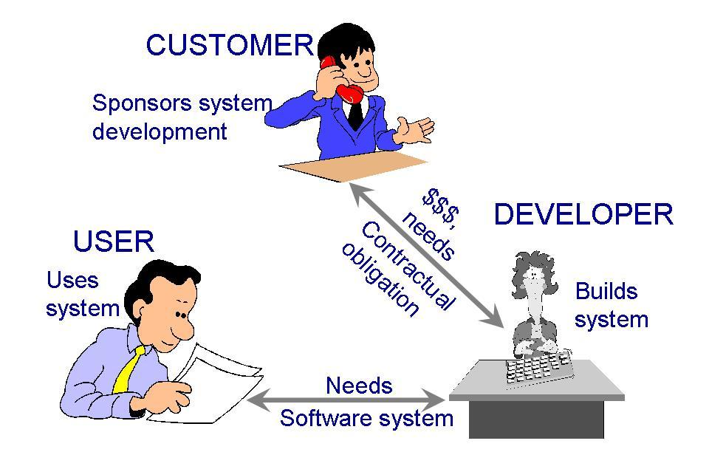
Who Does Software Engineering?
Participants (stakeholders) in a software development project
SOFTWARE ENGINEER

Slide 9
Development/SE Team
Requirements analysts: work with the customers to identify and document the requirements
Designers: generate a system-level description of what the system is supposed to do
Programmers: write lines of code to implement the design
Testers: catch faults
Trainers: show users how to use the system
Maintenance team: fix faults that show up later
Librarians: prepare and store documents such as software requirements
Configuration management team: maintain correspondence among various artefacts

Slide 10
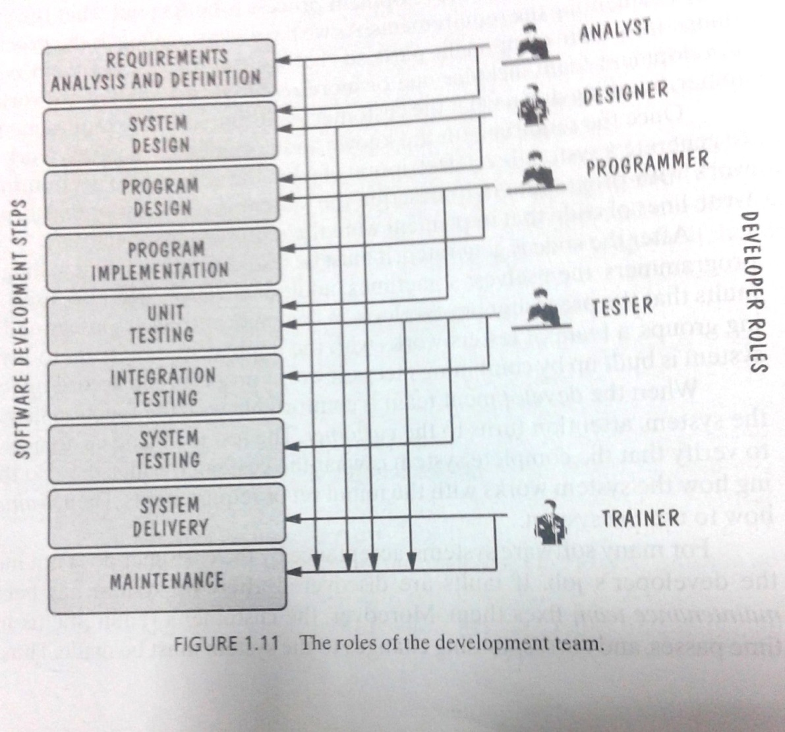
Development Team (Roles)
Who Does What?

Slide 11
Software Lifecycle
Phases
  Requirements analysis and definition
  System (architecture) design
  Program (detailed/procedural) design
  Writing programs (coding/implementation)
  Testing: unit, integration, system
  System delivery (deployment)
  Maintenance

Slide 12
Software Engineering and Software Quality

Slide 13
Software Engineers?
Adopt a systematic and organized approach, effectively, to produce high quality software
May have to use Ad hoc approaches to develop software
    Some real complex problems may not be solved using elegant theories of CS
    new algorithms?
Adopt a systematic and organized approach, effectively, to produce high quality software
May have to use Ad hoc approaches to develop software
    Some real complex problems may not be solved using elegant theories of CS
    new algorithms?
Improve living standards

Slide 14
Defects and Software Quality
Defect
  Failure to meet requirements (or expectations) of user/customer (Kan 2002)
Software Quality
  Fitness for Use (Juran and Gryna 1970)
  Conformance to Requirements (Crosby 1979)
  Freedom from Deficiencies (Juran 1988)
  Lack of Defects (Kan 2002)
Removal of defects, increases quality, incurs cost.

Slide 15
Cost Associated with Defect Correction
Unit Cost to fix a defect
Defects prevention can reduce costs.
Requirements Analysis | Design | Coding | Testing and Deployment* | Operations
*Testing the system before delivery and at the time of delivery
(Khoshgoftaar et al. 1996 , Galin 2004)

Slide 16
Costs in Software Engineering
Cost to change software
Cost to overcome a mistake (defect)
Cost of developing software
Operational cost
Deployment cost

Slide 17
Software Engineering Challenges
… good enough software
Acceptable Quality
  Usability
  Security
  Reliability
  Performance
Cost Effectiveness
  Engineering and operational feasibility
  Limited development budget
Timely Completion
  Limited time
Conflicts?
Manage Conflicts…

Slide 18
Software Engineering
Disciplined, consistent, and systematic effort to construct (design + build) and maintain software in timely and cost-effective manner

Slide 19
References
Roger Pressman, Software Engineering: A Practitioner’s Approach
Ghezzi et al., Fundamentals of Software Engineering
Pfleeger et al. Software Engineering, Theory and Practice

